Slide 1

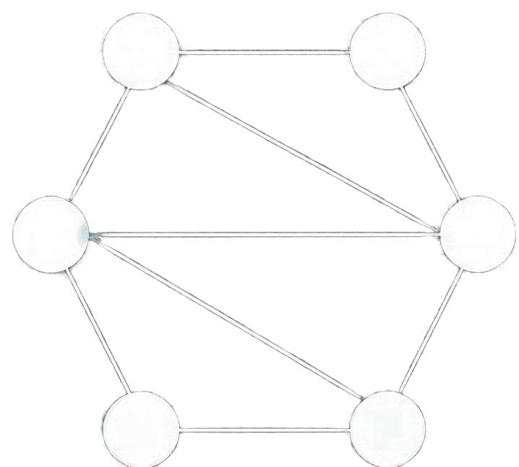

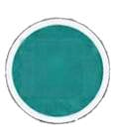





Minimum Spanning Tree Using
Prim’s Algorithm
4
A
B
2
7
6
3
C
D
5
8
1
Graph Theory and Greedy Algorithms
E
F
2
Sanket Bhagat | PRN: 26070521504 | Division D

Slide 2

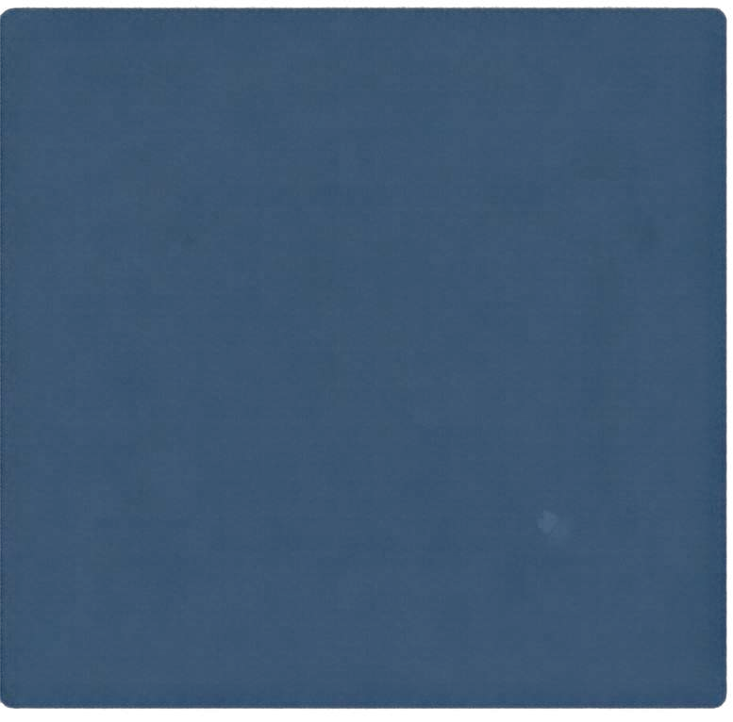
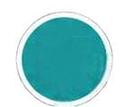
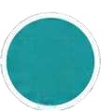
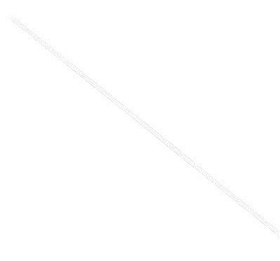

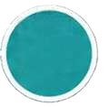

INTRODUCTION TO GRAPHS
EXAMPLE: UNDIRECTED WEIGHTED GRAPH
4
A B
Graph: A set of vertices connected by edges
Vertices: The points or nodes in a graph
Edges: The connections between vertices
Weighted graph: Edges have numerical weights
Connected graph: There is a path between every pair of vertices
5
2
1
C
D
3
Spanning tree: A subset of edges that connects all vertices without any cycles

Slide 3

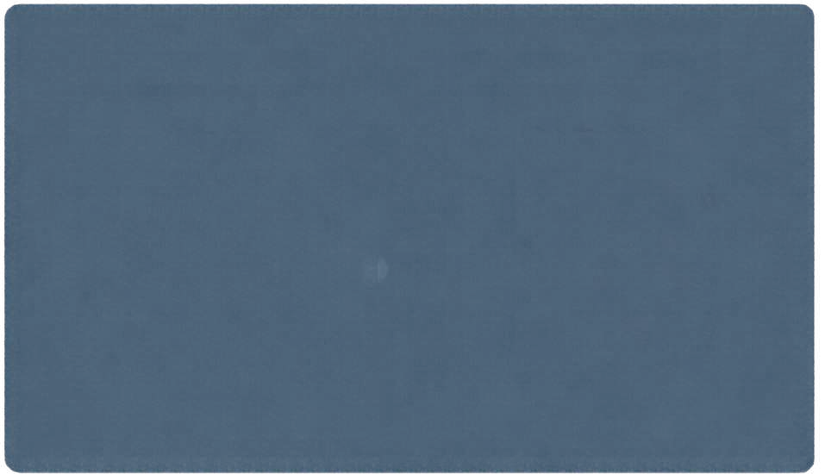
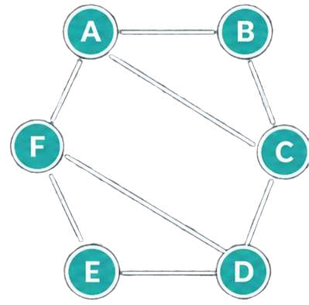
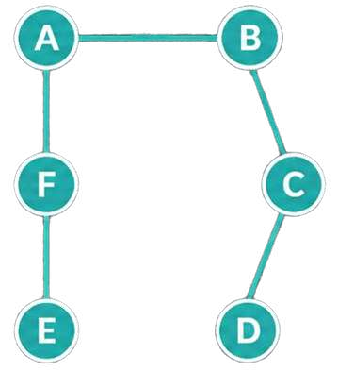

What is a
Minimum Spanning Tree?
Original Graph
Minimum Spanning Tree
Connects all vertices of a connected undirected graph
1
4
4
3
2
3
2
Contains exactly V — 1 edges
Minimizes the total sum of edge weights
Has no cycles
5
5
1
4

Slide 4
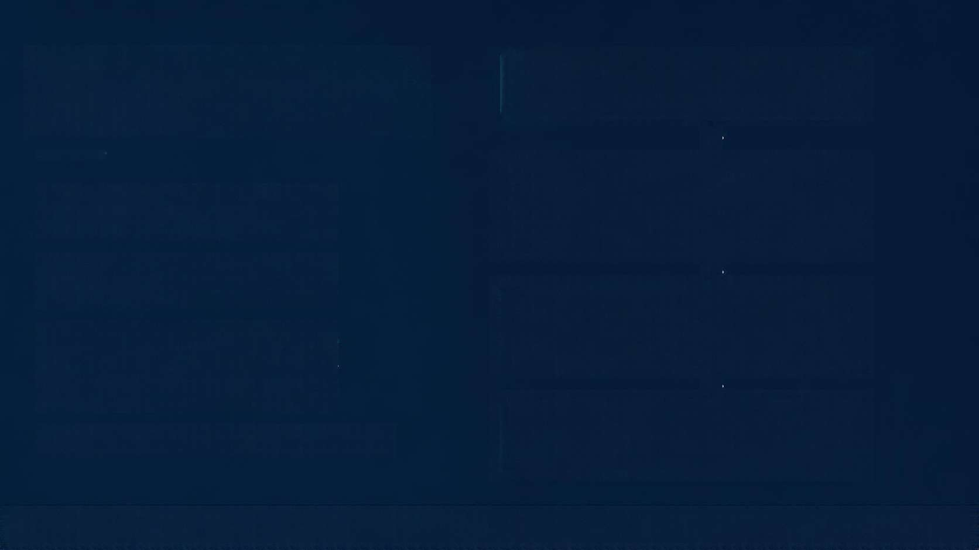




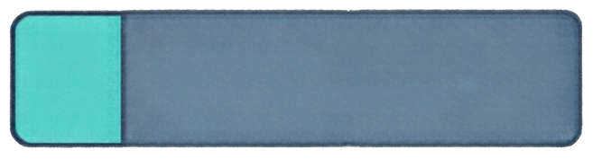

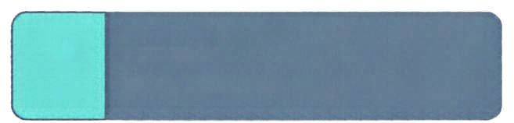
PRIM’S ALGORITHM OVERVIEW
01
INITIALIZE
Choose any starting vertex.
02
SELECT EDGE
Pick the minimum-weight edge that connects the tree to a new vertex outside it.
A greedy approach to build the
minimum spanning tree
Start from any vertex and form the
initial tree
03
ADD TO TREE
Include the new vertex and the selected edge in the tree.
Add the minimum-weight edge that connects the tree to a new vertex outside it
Repeat until all vertices are included
04
REPEAT
Repeat the process until all vertices are included.

Slide 5

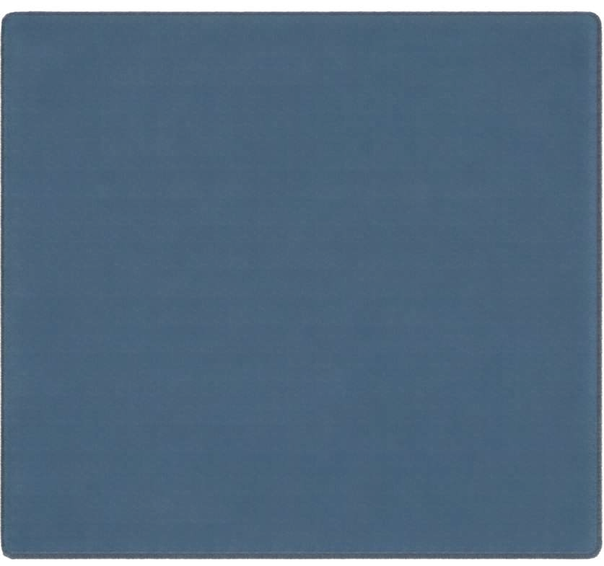




PRIM’S ALGORITHM PSEUDOCODE
01
Choose any start vertex s MST ← Ø
Visited ← {s}
Initialize Start the MST from any chosen vertex.
02
while Visited does not include all vertices
Select Repeatedly pick the minimum-weight edge that connects a vertex inside the MST to a vertex outside it.
Add include that edge and the new vertex in the MST.
03
Find the minimum-weight edge (u, v) where u ∈ Visited and v ∈ Visited
MST ← MST U {{u, v}}
Visited ← Visited U {v}
04
Terminate Stop when all vertices are included in the MST.
05
end while return MST

Slide 6
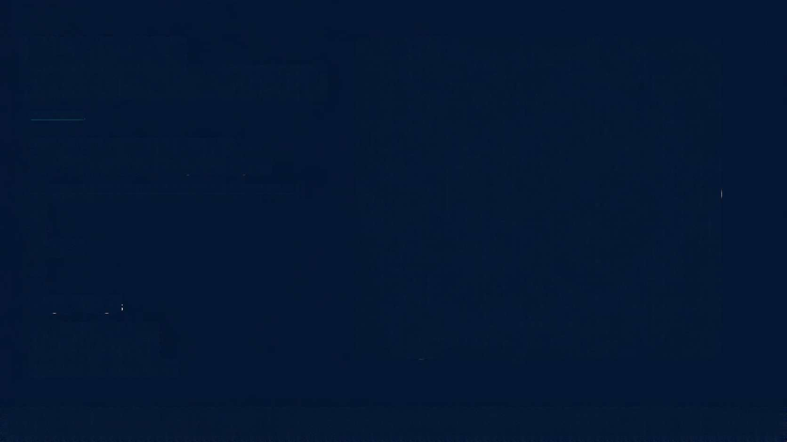
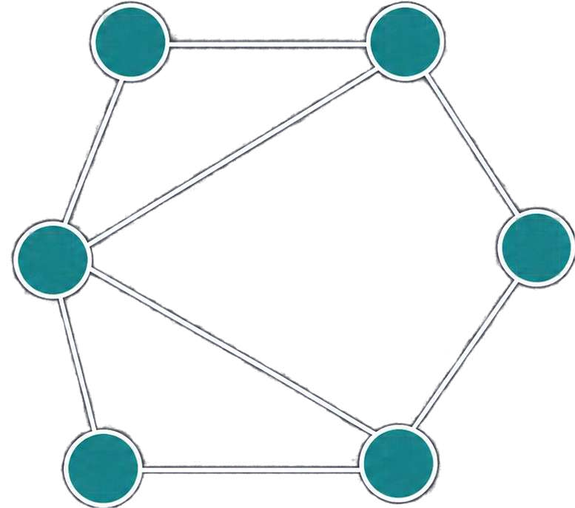
EXAMPLE WEIGHTED GRAPH
3
A
B
4
1
A connected, undirected graph
with six vertices and weighted edges.
3
D
C
6
vertices
8
weighted edges
Undirected
edges have no direction
5
6
2
F
E
7

Slide 7

STEP-BY-STEP MST CONSTRUCTION USING PRIM’S ALGORITHM
3
A
B
Iteration
Selected Edge
Weight
Vertices Included
Cumulative Cost
3
1
4
1 | A–D | 1
2 | A–B | 3
3 | B–C | 4
4 | C–E | 2
5 | E–F | 7
A, D
1
A, B, D
4
D
C
A, B, C, D
8
6
2
5
A, B, C, D, E
10
F
E
A, B, C, D, E, F
17
7
Teal = selected MST edge | Subdued = not selected

Slide 8
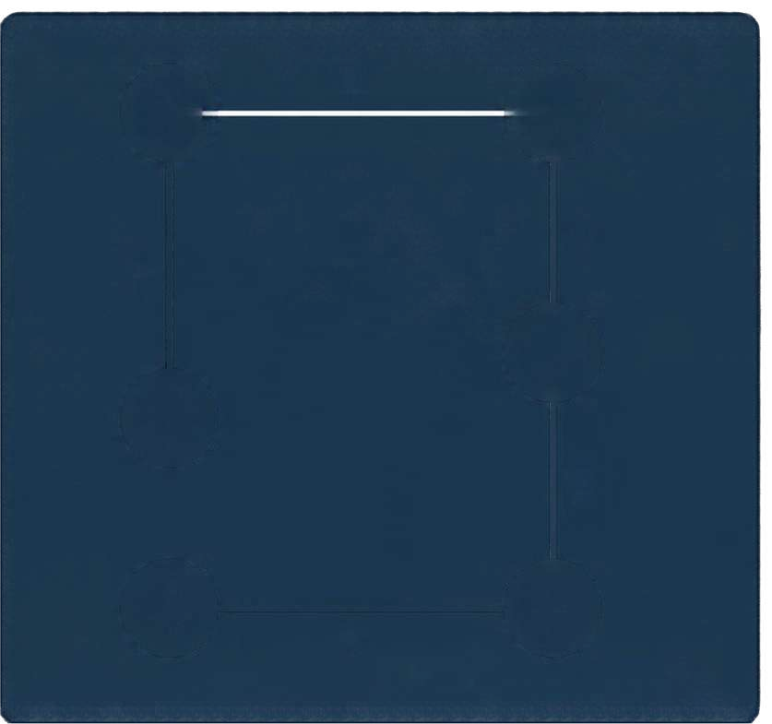



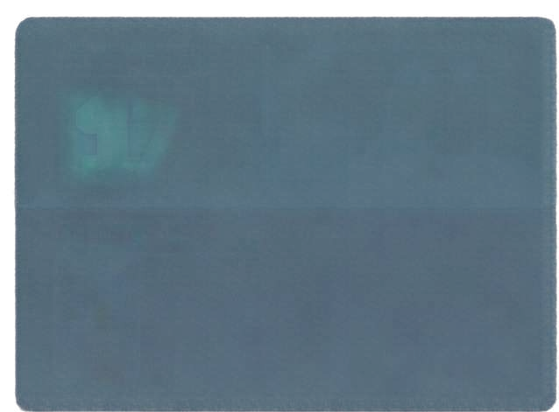



FINAL MINIMUM
SPANNING TREE
The minimum spanning tree connects all vertices with the least total cost.
3
A
B
4
1
C
TOTAL COST
17
SELECTED EDGES
A-D (1)
A-B (3)
B-C (4)
C-E (2)
E-F (7)
EDGES SELECTED
5
= V – 1 for 6 vertices
D
2
F
E
7

Slide 9

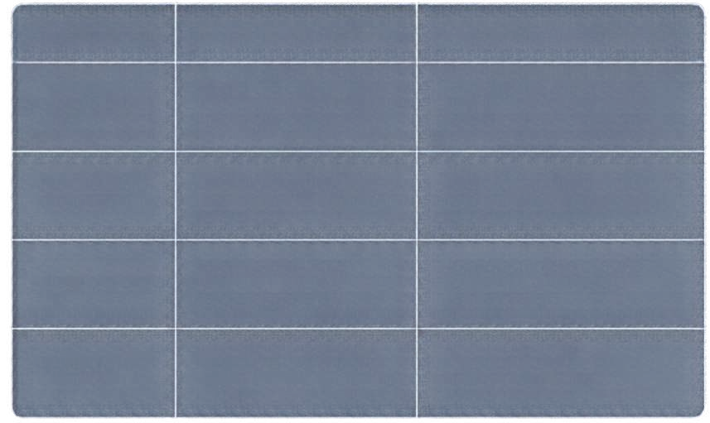
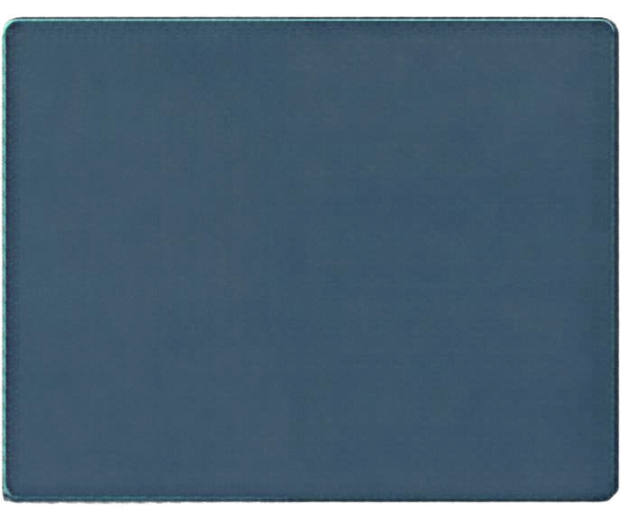


Applications and Comparison with Dijkstra’s Algorithm
Prim's Algorithm
Dijkstra's Algorithm
Finds minimum spanning tree
Finds shortest paths from source vertex
APPLICATIONS
Objective
Network cabling
Connects all vertices
Path-specific distances
Coverage
Communication networks
Minimizes total edge weight
Minimizes distance from source
Optimization
Infrastructure planning
Output
Minimum spanning tree
Shortest path to each vertex
Circuit design
Different goals, different results — choose the algorithm that matches the problem.

Slide 10

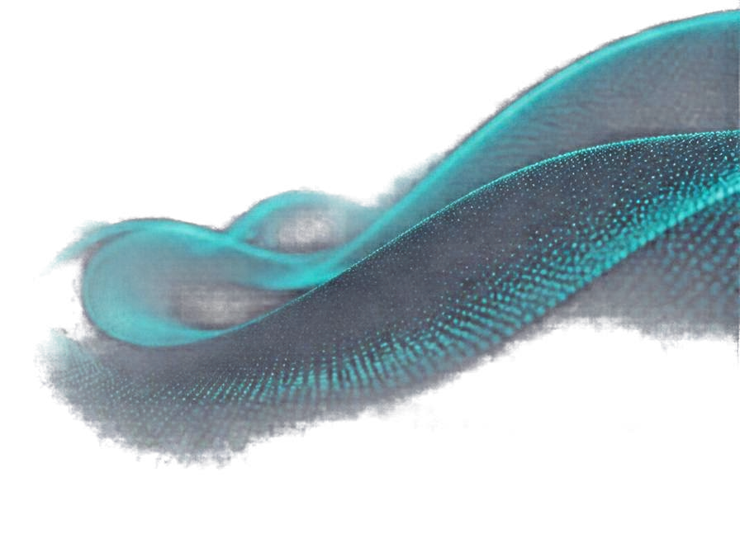
CONCLUSION AND ACKNOWLEDGEMENT
MSTs provide optimal connections with minimum total weight.
Prim’s algorithm builds MSTs efficiently with a greedy, incremental approach.
These concepts are foundational in graph theory and real-world applications.
THANK YOU
FOR YOUR ATTENTION
Understanding them enables better solutions to network design and optimization problems.
AI TOOL USED
Canva AI (Magic Design / AI Presentation Generator)
ACKNOWLEDGEMENT
AI assistance was used for presentation drafting and design; algorithm calculations and diagrams should be verified for correctness.
PRESENTED BY
Sanket Bhagat
PRN
26070521504
DIVISION
D

